Slide 1
Golang x Docker Building small Golang Docker image
kevingo
Notes:
大家好，我是 xxx，玩 golang 的時間沒有不長，今天是要來跟大家分享一個前陣子研究的一個 topic

Slide 2
故事是這樣開始的
Notes:
故事是這樣開始的

Slide 3
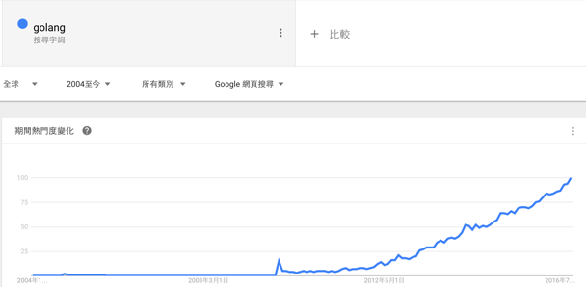
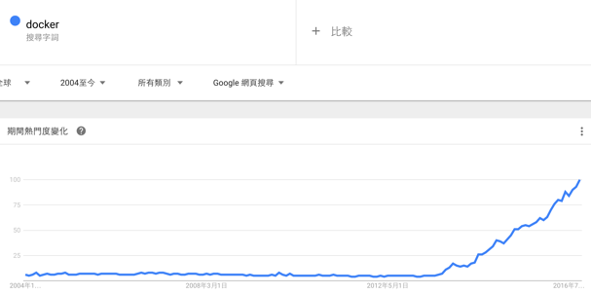
Golang X Docker

Slide 4
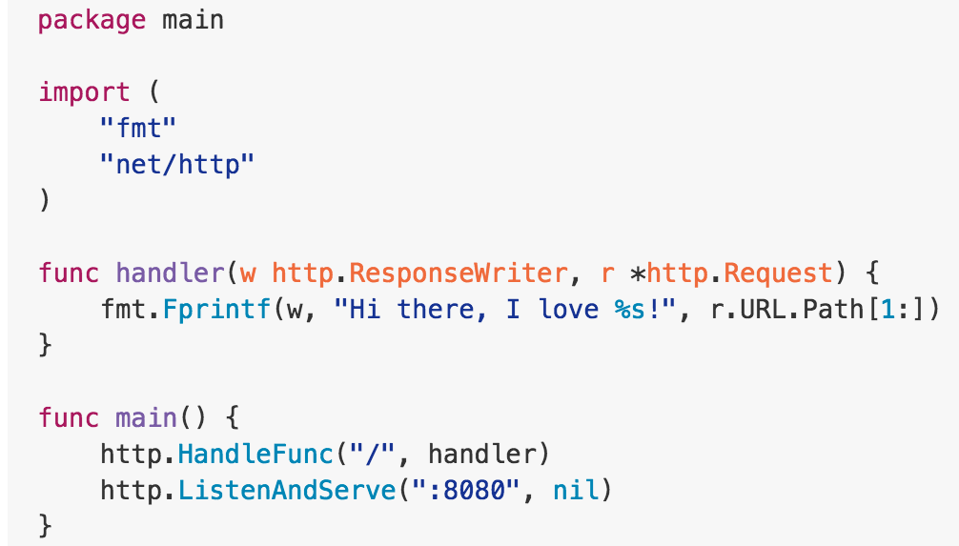
Simple Go HTTP Server
Notes:
在練習或把玩 golang 的過程中，你很有可能會先從一個很簡單的 web server 開始

Slide 5
Docker + Golang
https://mushfiq.me/2016/02/09/dockerize-your-golang-application/

Slide 6
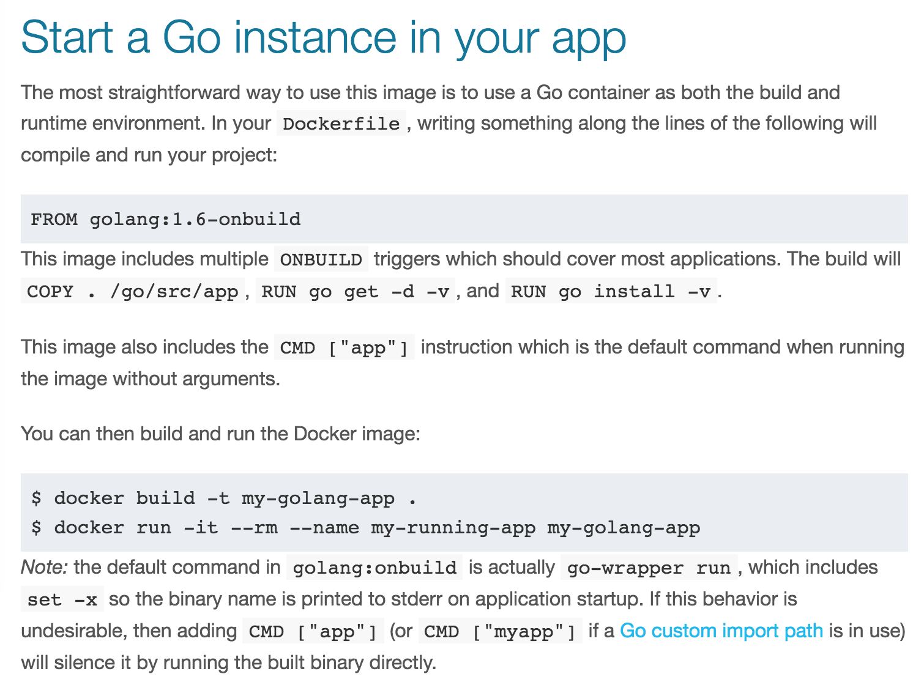
https://hub.docker.com/_/golang/

Slide 7
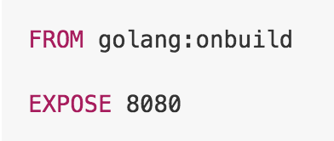
寫 Dockerfile

Slide 8
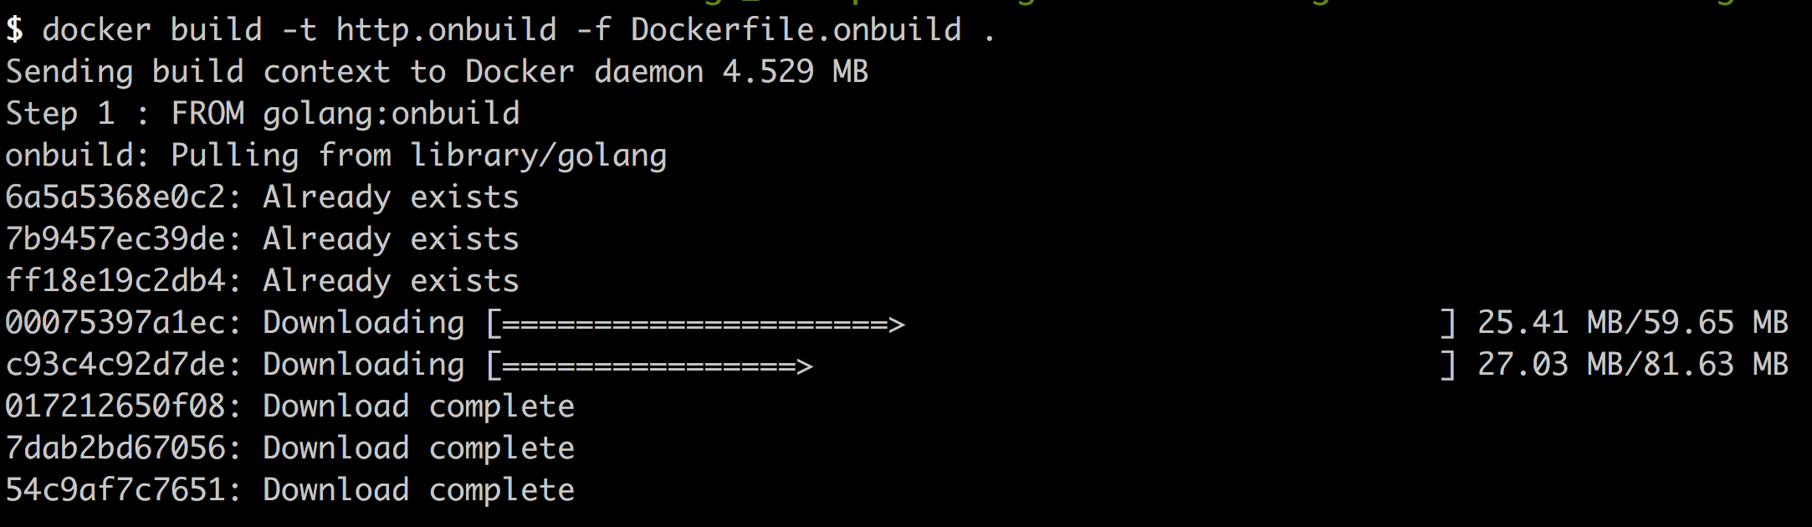
Build

Slide 9
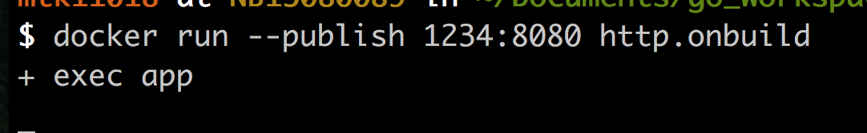
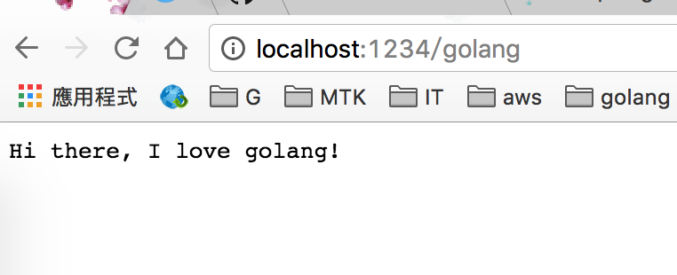
Everything works fine

Slide 10
Deploy
http://edu.delestra.com/docker-slides/img/docker_hub_auto_build.png

Slide 11
Docker image size

Slide 12
吃頻寬、吃 storage …

Slide 13
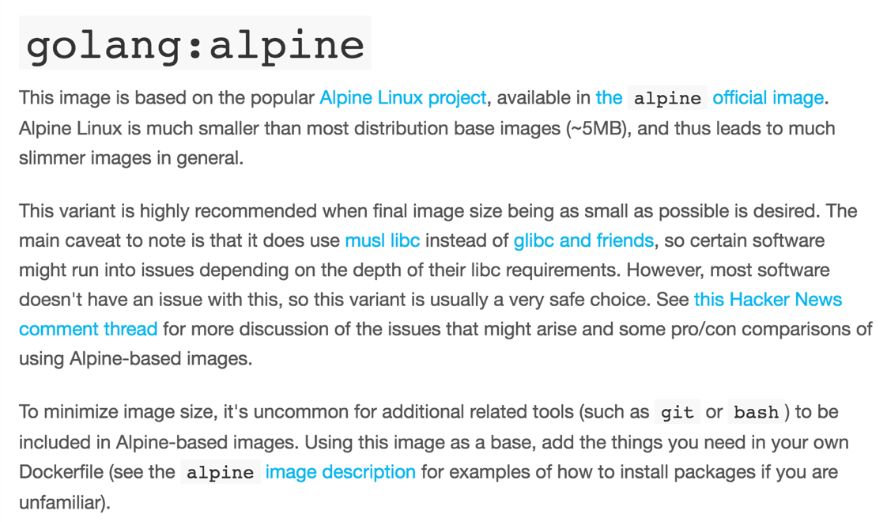
Alpine
https://hub.docker.com/_/golang/

Slide 14
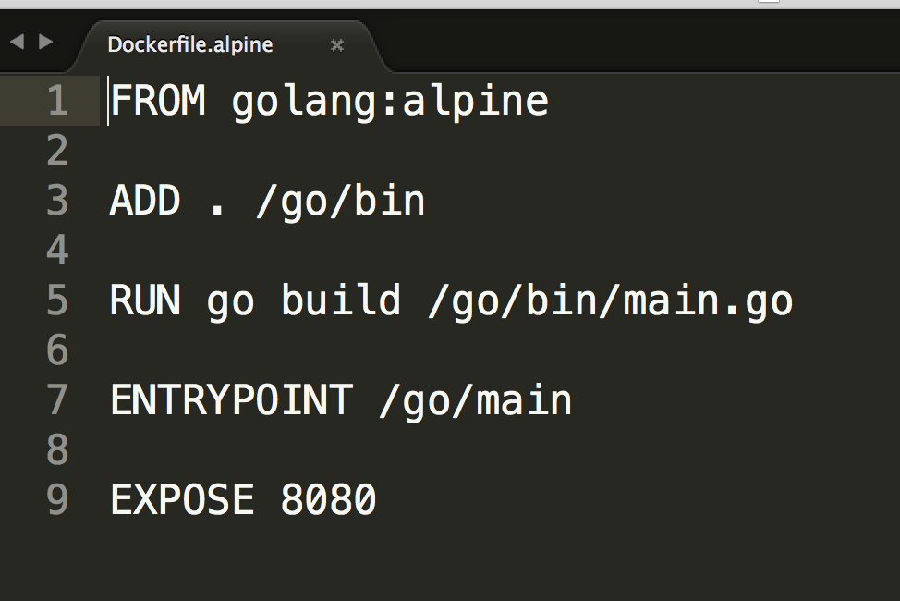
Using golang alpine image

Slide 15
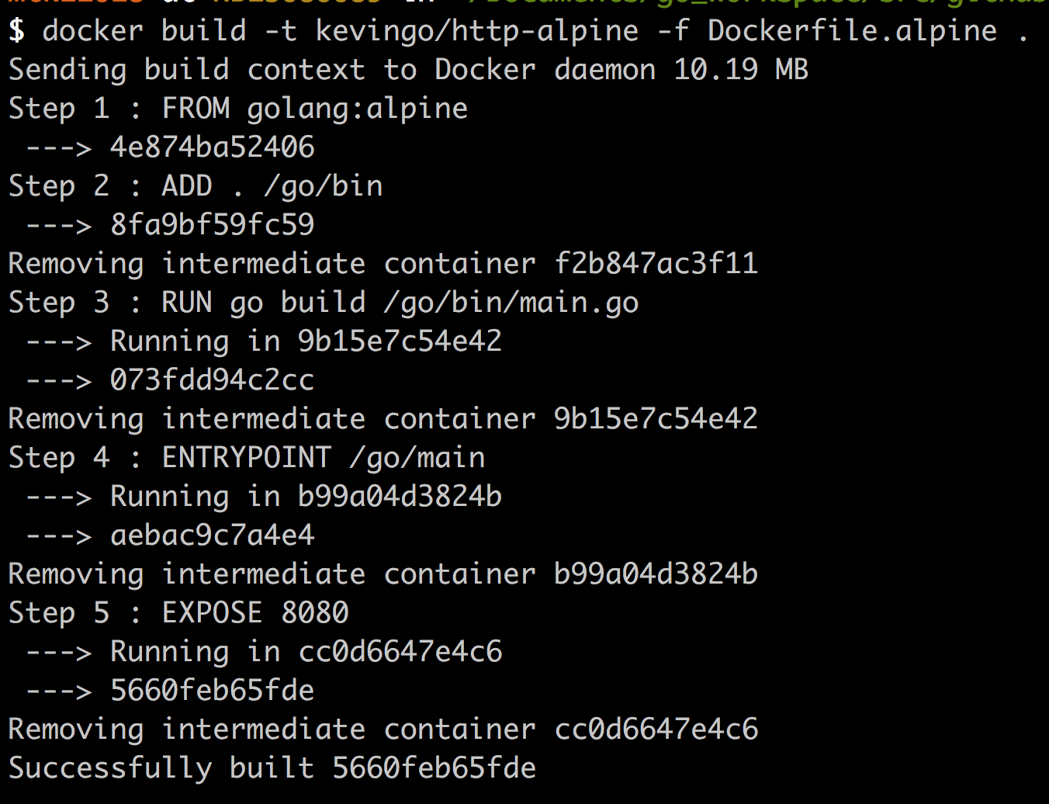
Build

Slide 16
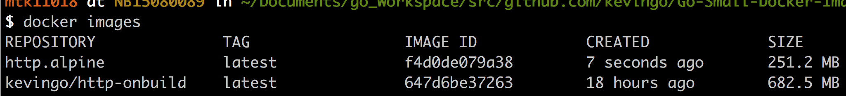
Docker image size

Slide 18
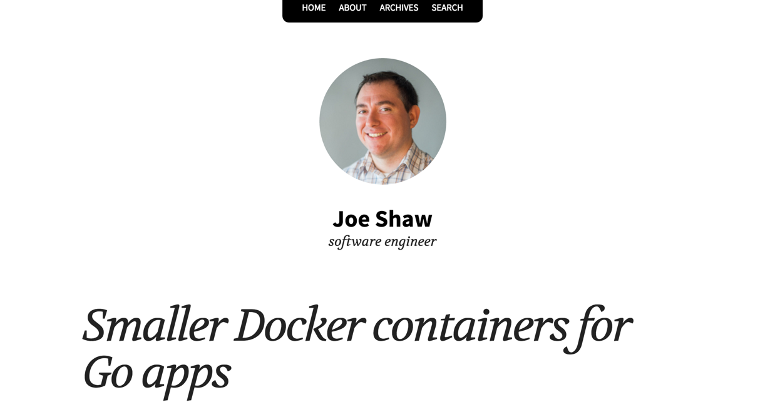
https://joeshaw.org/smaller-docker-containers-for-go-apps/

Slide 19
Using two containers
Builder Container
Runner Container
大
小

Slide 20
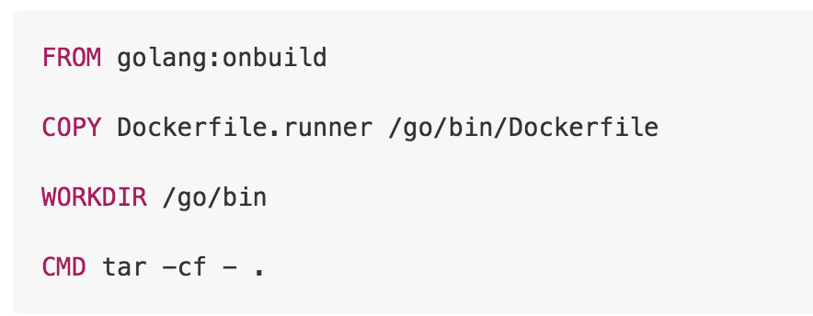
Builder Dockerfile
Build binary
Copy runner Dockerfile
tar output stream

Slide 21
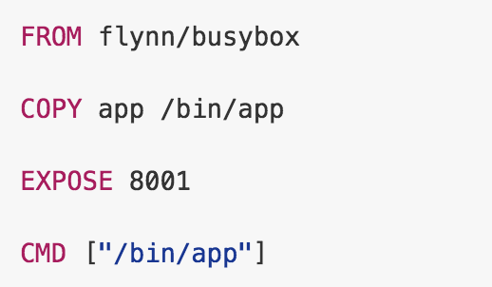
Runner Dockerfile

Slide 22
Just one line
Build builder image
Build runner image (using builder image output)

Slide 23
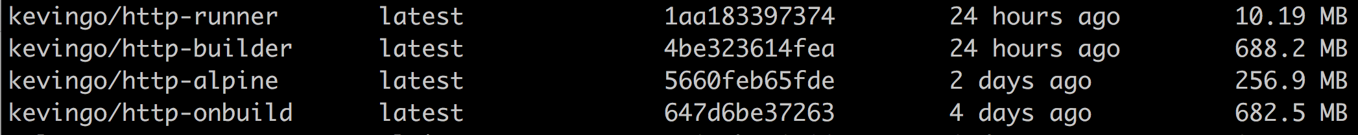
Docker image size

Slide 24
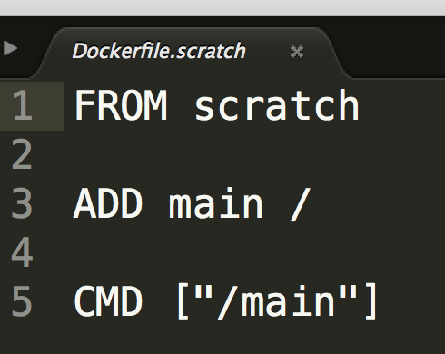
同場加映 - Static Build + Scratch Docker image

Slide 25
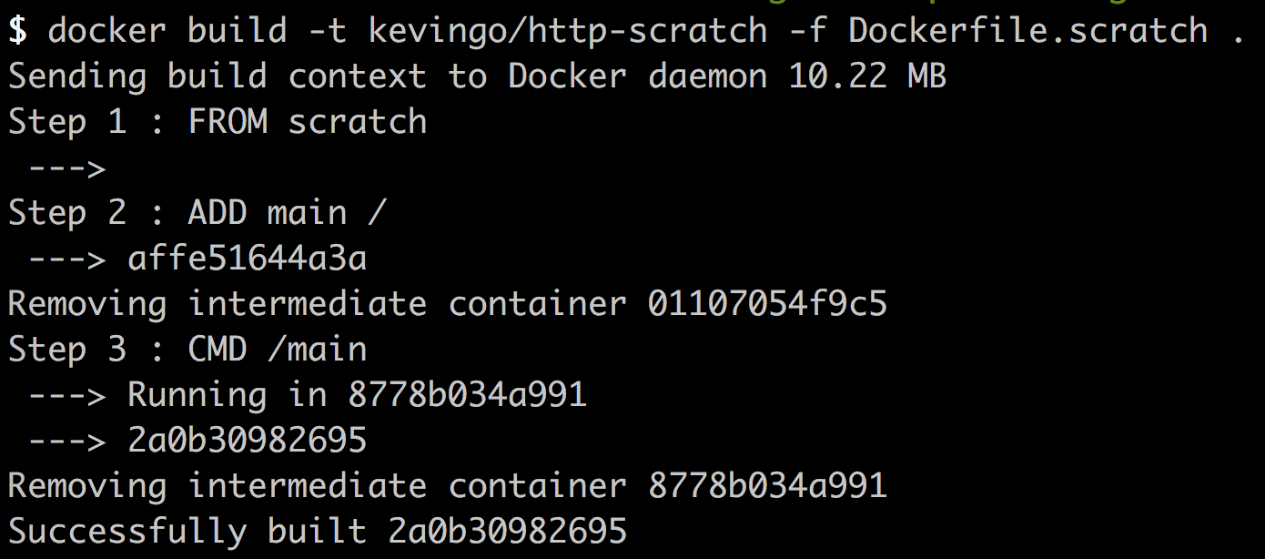
Build

Slide 26
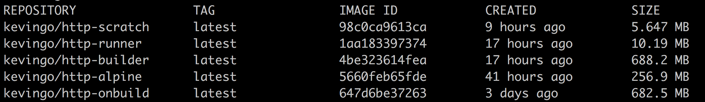
Image size

Slide 27
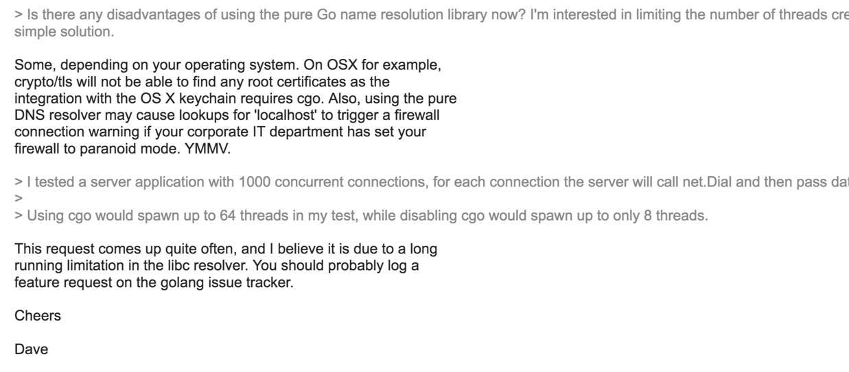
使用前請詳閱公開說明書
https://groups.google.com/forum/#!topic/golang-nuts/b3yS0uv05QE

Slide 28
https://blog.golang.org/go1.7-binary-size

Slide 29

Thanks!
https://github.com/kevingo/Go-Small-Docker-Image
@kevingo
Kevingo Tsai

